Slide 1


Slide 2
Overview of this Session
This Session will cover the Components of Lakhpati planning

Slide 3
Questions to consider during lakhpati planning of SHG HHs
WHY?
WHAT?
HOW?
Lakhpati planning
Elements of support
Planning approach
Field evidences

Slide 4
WHY?
Lakhpati planning
Elements of support
Planning approach
Field evidences

Slide 5
Why the HH should explore additional livelihood options?
Education for Children
Quality of Life
Financial Security
Health
Enough Disposable Income
Enhanced returns and savings
Lakhpati Didi (Rs. 1 Lakh+)
Strengthening Livelihoods
Potential Lakhpati Didi
Linked with CRPs
Have Potential and Interested
Lakhpati planning
Elements of support
Planning approach
Field evidences

Slide 6
WHAT?
Lakhpati planning
Elements of support
Planning approach
Field evidences

Slide 7

What components a family must include in the Lakhpati Plan?
Group Discussion -3 Groups
10 Mins
Lakhpati planning
Elements of support
Planning approach
Field evidences
Notes:
The Facilitator will pose a query against the participant, that how a household decides on the livelihood activity

Slide 8
5 A Framework
Ability (or Skill): Refers to the skills, knowledge, and physical capability of individuals or communities
Access: Involves the availability and reachability of resources, services, and opportunities. This includes access to markets, information, technology, infrastructure, and financial services.
Assets: Assets can be tangible, like land, equipment, livestock, or money, and intangible, such as social networks, reputation, or skills.
Attitude: It includes aspects like willingness to take risks, openness to change, resilience in the face of adversity, and the overall outlook towards life and work.
Affiliation: it refers to the social and institutional relationships and networks that people are part of. Affiliations can influence decision-making and power dynamics within communities
Lakhpati planning
Elements of support
Planning approach
Field evidences

Slide 9

Outside Support Possible out of 5‘A’s
Assets
(Equipment, Infrastructure)
Skill
(Training, Capacity Building/ Exposure etc)
Assets:
Physical Infra supporting livelihoods
Natural and other Assets
Access
(Market and Finance – Loan/ Subsidy etc))
Access:
to Finance loan, schemes,
to Information
to Market
  Direct Access
  Aggregation through PG/PE/FPO etc
Skills:
Ability to take the LH activity up
  Knowledge
  Skills
Lakhpati planning
Elements of support
Planning approach
Field evidences
Notes:
The facilitator will link the previous responses with this slide and categorized the responses of the participants on the previous slide.

Slide 10
Asset- Example
Equipment | Infrastructure | Livestock & Animal Resources
Farming: Solar Pump, thresher, sprayer, sprinkler, de seeder etc. Animal Husbandry: Containers, weighing scales, air blowers, water pumps, etc Non-farm Enterprise: Pottery Wheel, coir machine, packaging machine, turmeric boiler, etc | Farming: Field bunds, field channels, Well, Pond, Dry yard, Storage hall. Animal Husbandry: Cattle shed, poultry sheds etc Non-farm Enterprise: Work-shed, Processing unit etc. | Livestock: cattle, pigs buffalo, poultry, goat /sheep, etc Breeding Resources: Breeding stock, AI Supplies, etc
Lakhpati planning
Elements of support
Planning approach
Field evidences
Notes:
The facilitator will link the previous responses with this slide and categorized the responses of the participants on the previous slide.

Slide 11
Ability or Skills - Examples
Technical Skills | Business Management Skills | Entrepreneurial Skills
Farming: Agro- Ecological Practices, Natural Farming, Post Harvest Management etc Animal Husbandry: Livestock Management, Nutrition and Feeding, Breeding, Shelter Management, Hygiene and Sanitation etc. Non-Farm Enterprise: Production Skills, Machine Operation and Maintenance etc | Farming & Animal Husbandry: Digital and Financial Literacy, Marketing, Legal and Compliances, etc. Non-farm Enterprise: Basic Business Management, Business Plan, Digital and Financial Literacy, Financial Management, Marketing, Legal Compliances etc. | Communication Problem Solving and Critical Thinking Group Dynamics Decision Making Negotiation
Lakhpati planning
Elements of support
Planning approach
Field evidences
Notes:
The facilitator will link the previous responses with this slide and categorized the responses of the participants on the previous slide.

Slide 12
Access - Examples
Access to Finance | Access to Market
SHG- Bank Linkage Individual Financing- Loans (eg. Bank loan, MUDRA etc) Schemes (State and Central Government)- Subsidy, Financing NRLM – CBO Finance (CIF/ PG/ FPO finance etc) | Access to Market through membership in Business Organisations like PG / PE/ FPO etc. Private Sector Partnerships Linkage with Start Ups Public Procurement Opportunities etc. E Commerce Rural Marts etc
Note: In addition to the equipment and Infrastructure, one must identify different inputs for the Livelihood activity. Eg. Seed, Fertilizer etc in farming activities, Medicines, fee and fodder for Livestock etc.
Lakhpati planning
Elements of support
Planning approach
Field evidences
Notes:
The facilitator will link the previous responses with this slide and categorized the responses of the participants on the previous slide.

Slide 13
HOW?
Lakhpati planning
Elements of support
Planning approach
Field evidences

Slide 14
Lakhpati Planning Approach
 | From | To
Enhancing Returns of exiting LH activity | Conventional Practices | Appropriate practices Tech adoption Value addition (primary & secondary) Market, including social media
Diversification for Sustained returns | Single Activity, intermittent income, high vulnerability | Multiple Activities Additional activity- Agriculture/ Horticulture/ Livestock/ NTFP/ Enterprise Regular income, reduced vulnerability
Environmental Sustainability | High dependency on resources and chemicals | Natural and Organic approaches
Social Security | Fallback Support System for reducing vulnerability | Insurance, Pension, Employment Guarantee
Lakhpati planning
Elements of support
Planning approach
Field evidences

Slide 15
Diversified livelihood planning
Sl No | Activities | Units | Net income (Rs/month)
1 | Fishery/poultry/goatry | One unit each | 25-30,000
2 | Didi Cafe/footwear store | One unit each | 15-20,000
3 | Fishery/poultry/vegetable/dairy/mustard oil processing | One unit each | 80,000
4 | Veg farming/fish farming | One unit each | 20,000
5 | Goatery/woolen products | One unit each | 25-30,000
6 | Agriculture/Fisheries/Livestock | One unit each | 10,000
Source: Cases submitted by SRLMs
Lakhpati planning
Elements of support
Planning approach
Field evidences

Slide 16
Lakhpati Livelihoods models

Slide 17
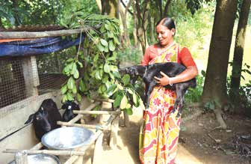
Evidence from field- Multiple Livelihoods making Lakhpati (Tripura)
Name – Aparna Deb, Khushi Mohila Dal
Activity - Poultry, Fishery, Goatery
Steps which were game changer –
Rs.2.9 lakh financing in multiple doses
Training and capacity building
Diversified livelihood activities
Earning ~Rs.20,000- 35,000/- per month from multiple livelihoods
Lakhpati planning
Elements of support
Planning approach
Field evidences

Slide 18
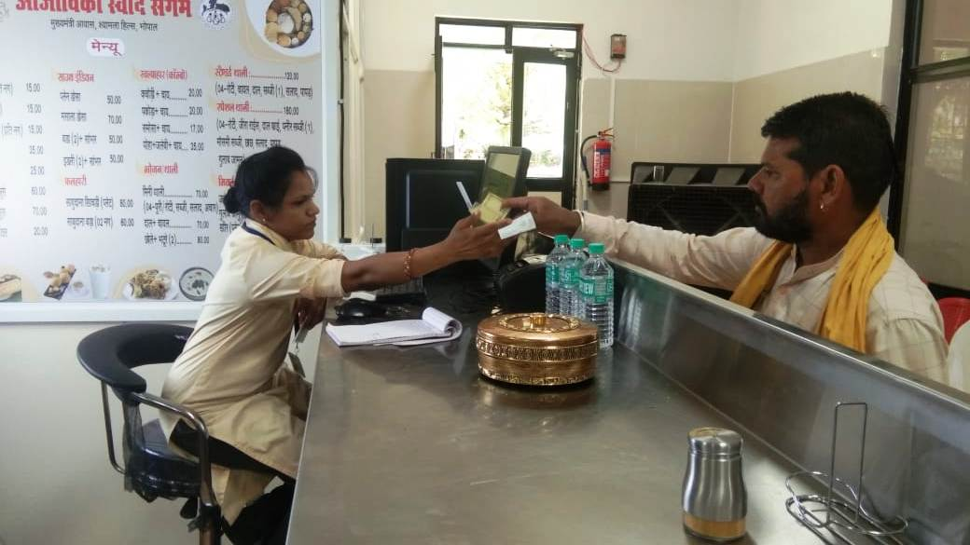
Evidence from field- Didi Café and Footwear Store (Madhya Pradesh)
Significant Steps which were game changers
Guided by the Mission, she joined the SHGs and started business of selling footwears.
Received culinary skills training
Financial assistance to start her café- Aajeevika Swad Sangam
Earning Rs 15-20,000/ month.
Manju Meware
Location –Fanda, Madhya Pradesh
Lakhpati planning
Elements of support
Planning approach
Field evidences

Slide 19
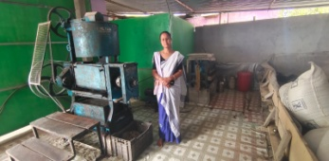
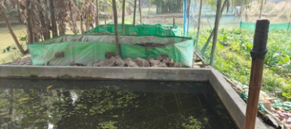
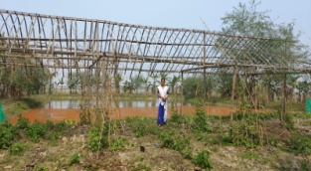
Evidence from field- Pashu Sakhi as Role model of Lakhpati didi (Assam)
Name – Smt. Nandita Chetia, Tinsukuia Dist
Steps which were game changer –
Multiple doses of loan-85K from SHGs and 8 Lakh from Bank
Multiple livelihood activities: Fishery, Poultry, Pig, Vegetables, Vermicomposting, Dairy, Mustard oil Processing
Inducted as Pashu Sakhi in 2022
Income has crossed Rs. 10 lakh per annum.
Lakhpati planning
Elements of support
Planning approach
Field evidences

Slide 20
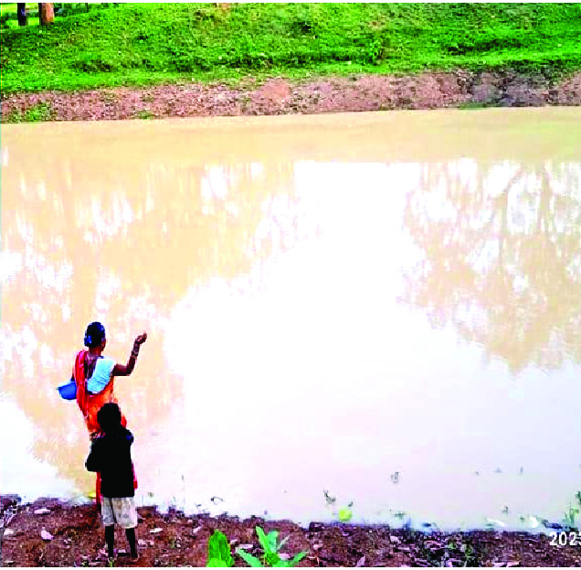
Evidence from field- Integrated Farming Cluster (Chhattisgarh)
Location – Geedam, Dantewada
Name – Janki Yadav
Activity - Fish farming and vegetable cultivation
Significant Steps which were game changer –
  Engaged in vegetable farming and fish farming.
  Financial support through Bank and CIF.
  ~ Rs 20,000 Per month
Lakhpati planning
Elements of support
Planning approach
Field evidences

Slide 21
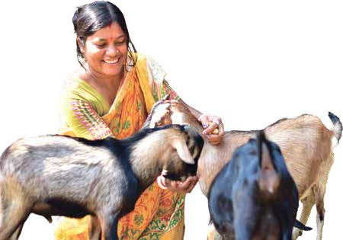
Evidence from field- Multiple Activities making Lakhpati (Tripura)
Name – Smt. Bindu Debnath
Activity - Goatery, Winter Products
Significant Steps which were game changer –
Inclusion into Self Help Group
Finances for livelihood
Financed through Self Help Group
Engagement in multiple livelihoods to minimize the risk factors
Sustainable livelihoods and average monthly income of Rs.25,000 - 30,000/- per month
Lakhpati planning
Elements of support
Planning approach
Field evidences

Slide 22
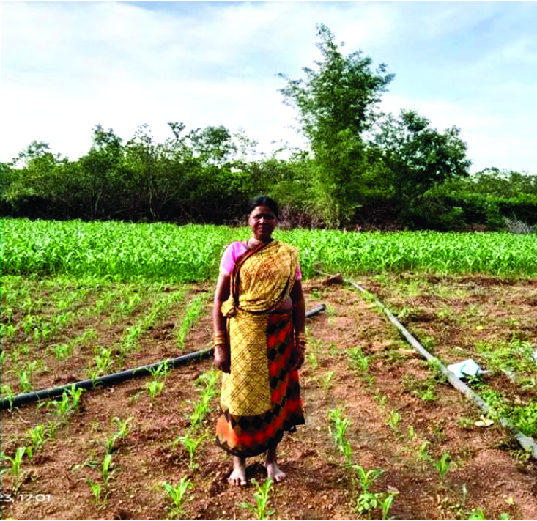
Evidence from field- Diversification of Activities (Chhattisgarh)
Location –Bastar, Chhattisgarh
Name – Naina
Activity – Agriculture + Fisheries + Livestock
Steps which were game changer
  Linking with SHGs
  Training and Capacity Building
  Financial support from SHG
  Training on diversified Livelihoods
  Enhanced income (₹1.4Lakh per year)
Lakhpati planning
Elements of support
Planning approach
Field evidences

Slide 23
Identify the Different requirements for Livelihood Planning
(Group Assignment)
Group Discussion -3 Groups
10 Mins
Notes:
The facilitator will divide the participants into groups and hand out the cost estimates required for various livelihood activities – Each group will be given one livelihood activity. The group members will be asked to identify the different factors required for the particular livelihood activity. This analysis will be a part of the Livelihood Planning exercise that CRPs will undertake with SHG member HHs in order to identify and finalise the livelihood activities they wish to undertake. Each group shall present their work at the end of the session using the format given in next slide

Slide 24
Name of the Livelihood Activity
ASSET | Equipment
 | Infrastructure
SKILLS | Skill Training/ Exposure Visit
ACCESS | Access to Finance
 | Access to Market
 | Inputs

Slide 25
Queries

Slide 26
Thank you

